Slide 1
Difficult Airway Management and Considerations for Intubation in COVID-19
T Fuhrman, MD, MMSc, FASA, FCCP, FAARC RRT
Suncoast Pulmonary Symposium 2022

Slide 2
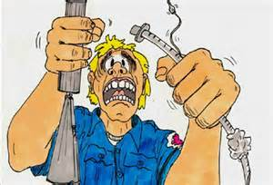
Don’t Panic!
Suncoast Pulmonary Symposium 2022

Slide 3
The Difficult Airway - Stategy
1. Evaluate the patient – Difficult Airway?
Possible Intubation?
2. Strategy - People/Equipment Available
3. Plans – A: Preferred Technique
B: Back-up(s)
C: If All Else Fails!
Suncoast Pulmonary Symposium 2022

Slide 4
JAMA February 5, 2019 Volume 3215
Suncoast Pulmonary Symposium 2022

Slide 5
JAMA February 5, 2019 Volume 3215
Suncoast Pulmonary Symposium 2022

Slide 6
The Difficult Airway - LEMON
Look
Evaluate the 3-3-2 rule. normal mouth opening is three fingerbreadths; allow three fingerbreadths between the mentum and the hyoid bone; and the notch of the thyroid cartilage should be two fingerbreadths below the hyoid bone
Mallampati score. To perform a Mallampati evaluation; patient seated, have the patient extend his neck, open his mouth fully, protrude his tongue, and say "ah.".
Obstruction.
Neck mobility.
Walls RM, Luten RC, et al. Manual of Emergency Airway Management. 2000
Suncoast Pulmonary Symposium 2022
Notes:
My wife always accuses me of looking at her veins; one of my cowrokers says her husband – who sells boats often points out people with difficult airways to her!
The Mallampatiexam can be approximated in supine and comatose patients using a tongue blade

Slide 7
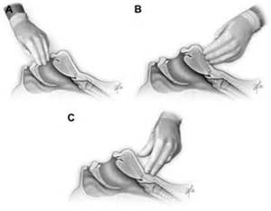
The Difficult Airway
3-3-2
Suncoast Pulmonary Symposium 2022

Slide 8
The Difficult Airway
Lessons Learned from the OR:
  Always Planning to Intubate
Best Possible Conditions
Patients are Prepared and Stable
All the Best Equipment in the Hospital
More Help than you Would Ever Need
Medications right at hand
Suncoast Pulmonary Symposium 2022

Slide 9
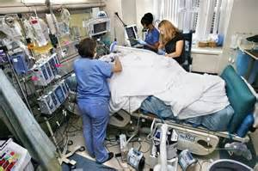
The Difficult Airway
Suncoast Pulmonary Symposium 2022

Slide 10
The Difficult Airway
Out of OR
Best conditions NEVER as good as the OR
Patient rarely really prepared
Often you are on your own!
Equipment – Down the hall or in the OR
Medications may be in Pixis or Pharmacy;
Patients are not always willing to wait!
Suncoast Pulmonary Symposium 2022

Slide 11
Airway Management - SAS
Safe For Patient and Staff.
Accurate Avoid Unfamiliar, Unreliable or Repeated
attempts.
Swift Timely, without rush or delay.
Anaesthesia 2020:75:785-799
Suncoast Pulmonary Symposium 2022

Slide 12
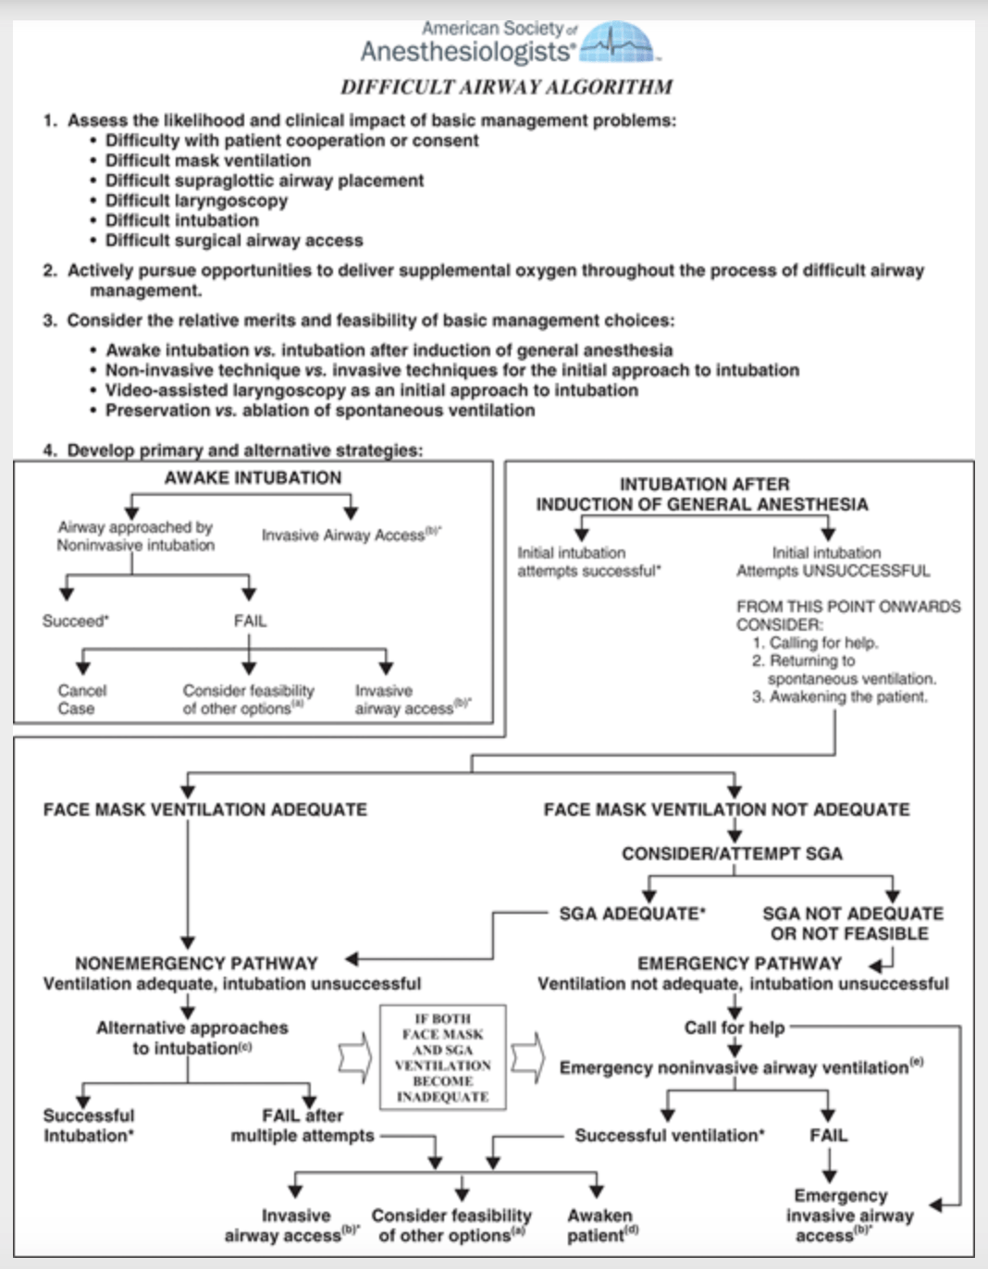
2022 American Society of Anesthesiologists
Practice Guidelines for Management of the Difficult Airway*Anesth 2022, 136, 31–81.
Suncoast Pulmonary Symposium 2022

Slide 13
Tracheal intubation in patients with COVID-19. Duggan LV, Mastoras G, et al. CMAJ June 01, 2020, 192:E607;.
Preoxygenate in a 30° head-up position.
HFNC, or Tight FM using 2 hands.
Inotropes and vasopressors immediately available.
Sedation, then use high-dose rocuronium (1.2–1.5 mg/kg)
ensure full neuromuscular blockade
Avoid BVM ventilation despite desaturation.
Have the most experienced personnel use a Video Laryngoscope
Use a styleted endotracheal tube and (?)avoid floppy bougies
Place a viral filter on the endotracheal tube, and inflate the cuff
so no leak occurs with positive-pressure ventilation.
Suncoast Pulmonary Symposium 2022
Notes:
Canadian Medical Association Journal

Slide 14
COVID-19 and Risks Posed to Personnel During Endotracheal Intubation
Weissman D, de Perio MA, Radonovich LJ JAMA 4/27/2020
Eliminate or substitute (avoiding elective intubations)*
PPE
Engineering controls (eg, using intubation boxes as barriers to droplet spray, using antiviral filters between the face mask and the manual ventilation device, and performing procedures in air-borne infection isolation rooms)
Administrative controls (eg, only essential personnel present during the procedures, and cleaning and disinfection of the room after the procedure)
Suncoast Pulmonary Symposium 2022

Slide 15
Comparison of three tracheal intubation methods for reducing droplet spread for use in COVID-19 patients. Yang SS, Zhang M, Chong JJR,
British Journal of Anaesthesia, https://doi.org/10.1016/j.bja.2020.04.083. 4/29/2020
Feldman et al reported the results of simulations of endotracheal intubation using a fluorescent marker to visualize deposition of simulated exhaled respiratory secretions and material from the body surfaces of adult and pediatric manikins onto health care personnel performing or assisting in endotracheal intubation procedures.
Personnel wore N95 respirators, eye protection, isolation gowns, and gloves. After the procedures, the investigators found fluorescent markers on the uncovered facial skin, hair, and shoes of the health care personnel performing the intubations.
Suncoast Pulmonary Symposium 2022

Slide 16
Comparison of three tracheal intubation methods for reducing droplet spread for use in COVID-19 patients. Yang SS, Zhang M, Chong JJR,
British Journal of Anaesthesia, https://doi.org/10.1016/j.bja.2020.04.083. 4/29/2020
The first test with direct laryngoscopy showed a large amount of dye on the laryngoscopist’s faceshield, gown, arms, glove, neck and hair.
The second test with the videolaryngoscopy technique showed significantly lower amount of dye on the laryngoscopist in similar locations, visually less than half the quantity compared to direct laryngoscopy.
The third test with videolaryngoscopy and the box showed dye only on the gloves and forearms within the box; no dye was visible on any part of the laryngoscopist located outside the box including gown, face shield, neck and hair.
Suncoast Pulmonary Symposium 2022

Slide 17
Comparison of three tracheal intubation methods for reducing droplet spread for use in COVID-19 patients. Yang SS, Zhang M, Chong JJR,
British Journal of Anaesthesia, https://doi.org/10.1016/j.bja.2020.04.083. 4/29/2020
Suncoast Pulmonary Symposium 2022

Slide 18
Intubation Box
Plastic/Transparent
Light weight
Easily cleanable
Reusable
“Relatively Cheap”
Suncoast Pulmonary Symposium 2022
Notes:
Coat hangar for stylet easily shoved beyond ETT and through trachea; autopsy of patients traches with stylet thru trachea.
VL
“Open” at bottom to allow assistance if needed but assistant really exposed!!!!!

Slide 19
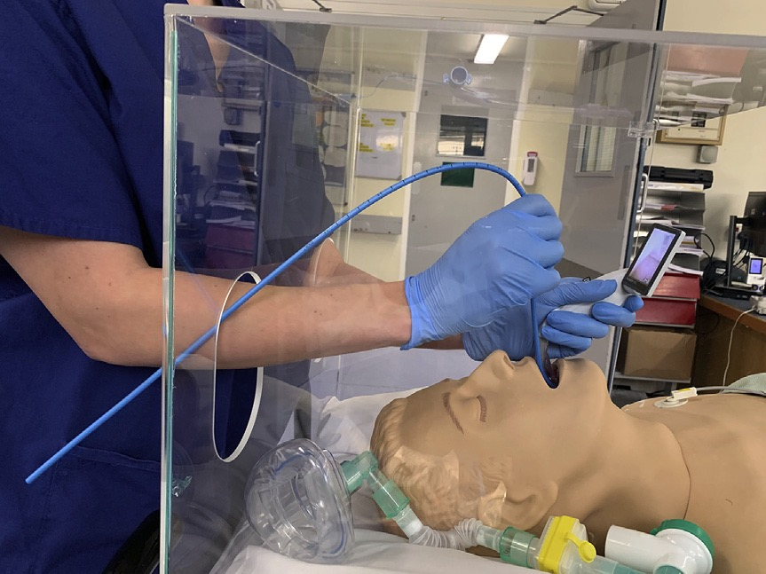
The Difficult Airway
Suncoast Pulmonary Symposium 2022

Slide 20
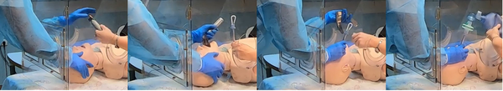
Feldman O, Samuel N, Kvatinsky N, Idelman R, Diamand R, et al. (2021) Endotracheal intubation of COVID-19 patients by paramedics using a box barrier: A randomized crossover manikin study. PLOS ONE 16(3): e0248383.
Suncoast Pulmonary Symposium 2022

Slide 21
The Difficult Airway
Extubation/Intubation are high risk for aerosolization of respiratory secretions; similar precautions should be followed.
Non-required personnel should leave the room before extubation, and then allow a number of air exchanges before reentry.
Who are required? Airway manager and assistant, RN and 1-2 outside room to supply needed equipment
Up To Date. Literature review current through: May 2021.
Suncoast Pulmonary Symposium 2022

Slide 22
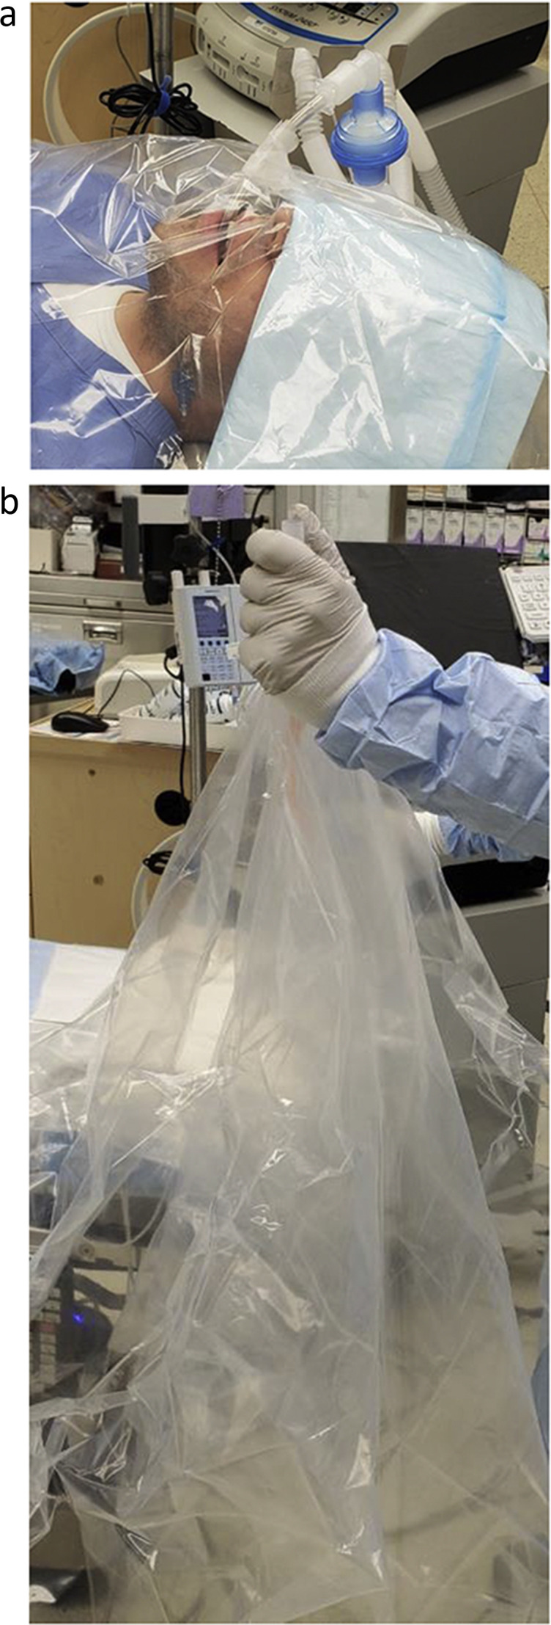
(a (
Extubation
Extubation barrier drape with tracheal tube emerging through a slit in the drape.
The drape then taped to the tracheal tube in a manner that seals the hole.
After extubation, Patient side of drape has collapsed over the tracheal tube and the whole unit can be discarded, protecting provider from contact with aerosolized droplets.
Suncoast Pulmonary Symposium 2022

Slide 23
COVID-19: Airway management concerns
- infection control, prevent spread of secretions
1.Secure a surgical mask on the patient while the endotracheal tube is still in place.
2. Place a wet gauze over the patient’s mouth and nose just prior to extubation. And/or covering the patient's face with a clear plastic drape or with the warming blanket. (if one is used it must be removed carefully and treated as biohazard.)
3. After extubation, place a surgical mask over the patient's airway. Apply a plastic mask for supplemental oxygen over the surgical mask, or nasal prongs under the surgical mask
Up To Date. Literature review: May 2021.

Slide 24
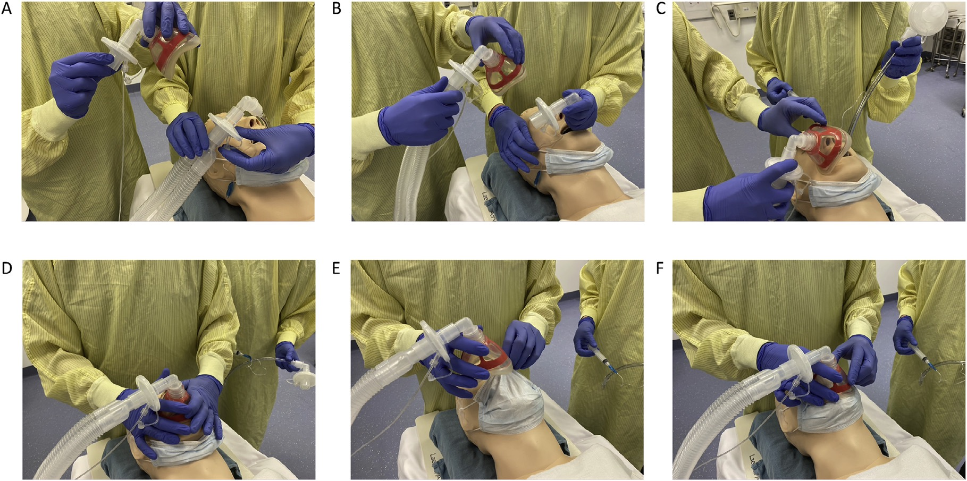
Extubating COVID 19 Patients is a SNAPP. Sampling line attached
to new filter. New filter is attached to circuit. Airway is removed.
Place oxygen mask on patient. Pull surgical mask up, reapply oxygen mask.
Modified tracheal extubation for patients with COVID-19. BJA 2020
This can be used for a large image or chart
Suncoast Pulmonary Symposium 2022

Slide 25
The Difficult Airway British Journal of Anaesth 115: 827–48 (2015).
Repeated attempts at inserting a SAD increases the likelihood of airway trauma and may delay the decision to accept failure and move to an alternative technique to maintain oxygenation.
Successful placement is most likely on the first attempt. In one series, insertion success with the ProSeal LMA was 84.5% on the first attempt, decreasing to 36% on the fourth attempt. A maximum of three attempts at SAD insertion is recommended; two with the preferred second-generation device and another attempt with an alternative. An attempt includes changing the size of the SAD.
Even supraglottic airways can fail. If effective oxygenation has not been established after three attempts, Plan C should be implemented.
Suncoast Pulmonary Symposium 2022

Slide 26
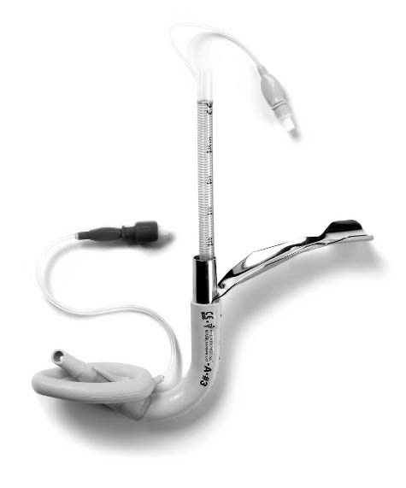
The intubating laryngeal mask airway
Emerg Med J 2005;22:47–49
Suncoast Pulmonary Symposium 2022

Slide 27
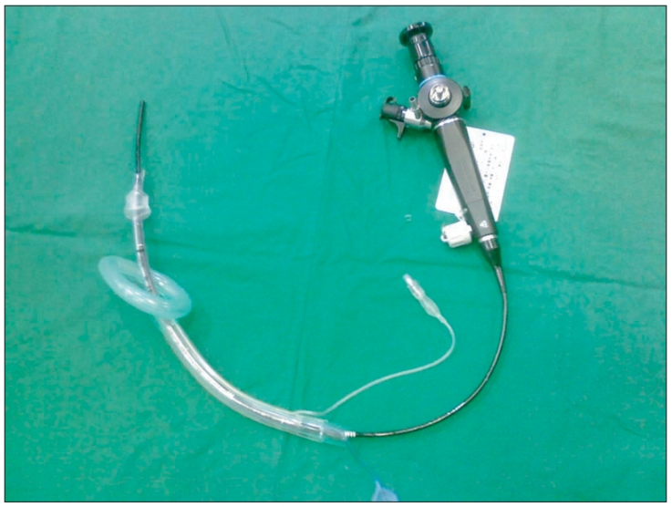
The Difficult Airway
Suncoast Pulmonary Symposium 2022

Slide 28
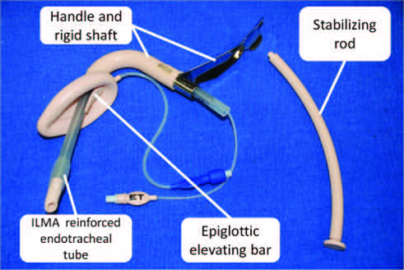
Suncoast Pulmonary Symposium 2022

Slide 29
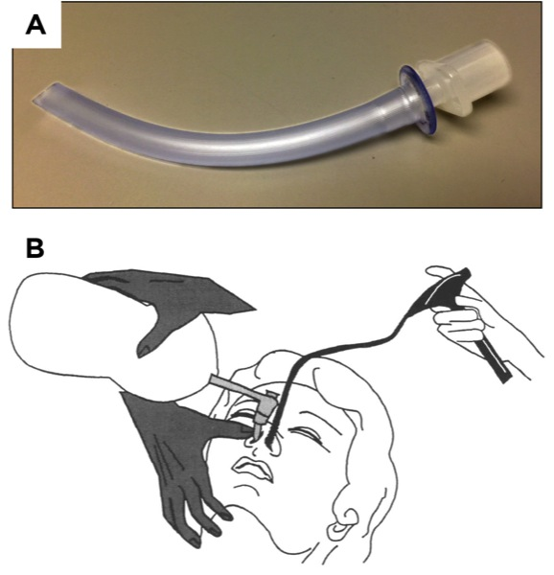
Airway Management
Suncoast Pulmonary Symposium 2022

Slide 30
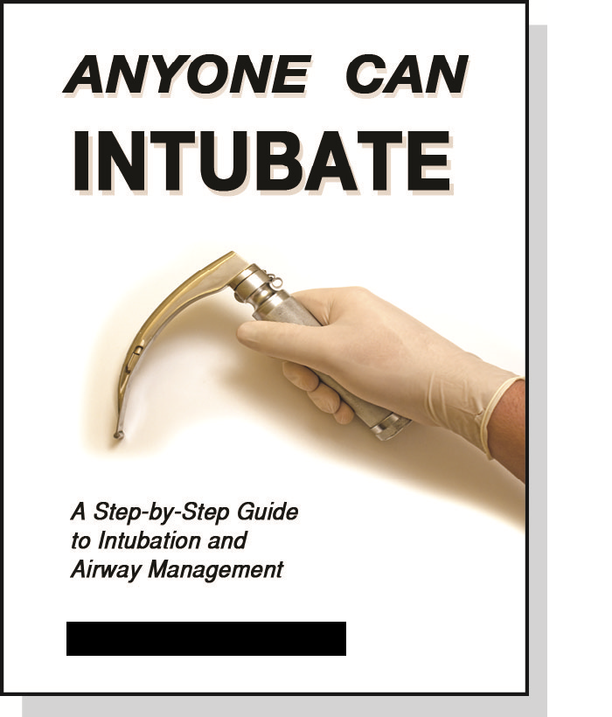
The Difficult Airway
Suncoast Pulmonary Symposium 2022
Notes:
Author is a Pedi Anesthesiologist from LA; I have read some of her other papers much better than this picture!

Slide 31
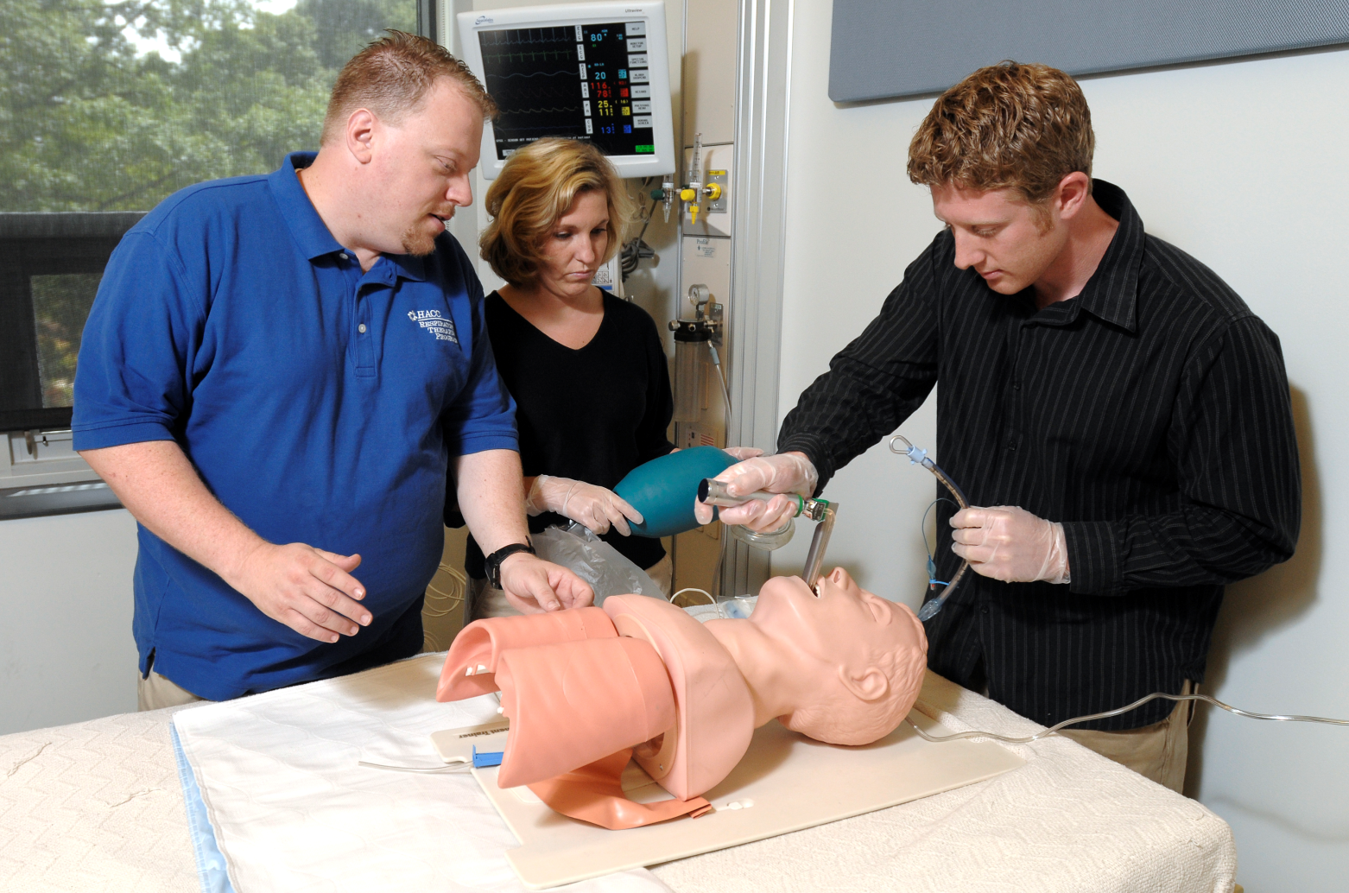
The Difficult Airway
Suncoast Pulmonary Symposium 2022

Slide 33
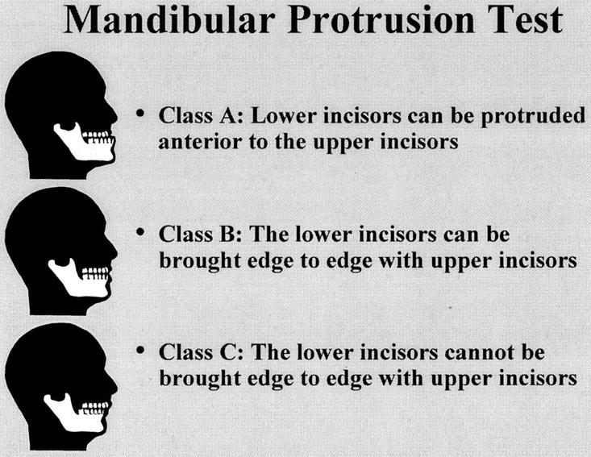
The Difficult Airway
Analg Anesth 2003;96:595-9; J Anaesthesiol Clin Pharmacol. 2013:29:313–317
.
Suncoast Pulmonary Symposium 2022
Notes:
There are severalpapers that have tried to compare the Mallampati and the Mandibular protrusion test; one said M better; another MP better; one equal and one said the combination was the best!???
Unblinded test – Diff A/W as determined by Cormack and Lehuen of 3-4
“More sensitive and more accurate then Mallampati
Comparison of Mallampati test with lower jaw protrusion maneuver in predicting difficult laryngoscopy and intubation
Muhammad Irfan Ul Haq and Hameed Ullah

Slide 34
Consider prophylactic medication/treatment for possible aspiration prevention. (Tube feeds, NG Tube and oro-pharynx suctioned?)
Prophylaxis for coughing before extubation . Options include IV, topical, or intracuff lidocaine, low dose opioids, and dexmedetomidine.
What to do after extubation: HFNC, NIV
Up To Date. Literature review current through: May 2021
Suncoast Pulmonary Symposium 2022

Slide 35
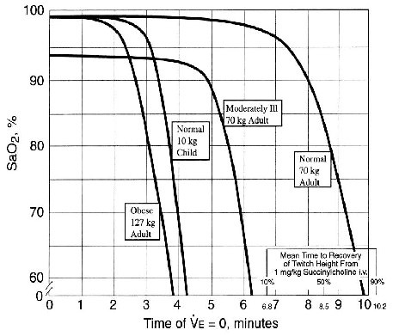
Critical Hemoglobin Desaturation Will Occur before Return to an Unparalyzed State following 1 mg/kg Intravenous Succinylcholine
Benumof JL, Dagg R, et al. Anesth 1997; 87: 979-982.
Suncoast Pulmonary Symposium 2022

Slide 36
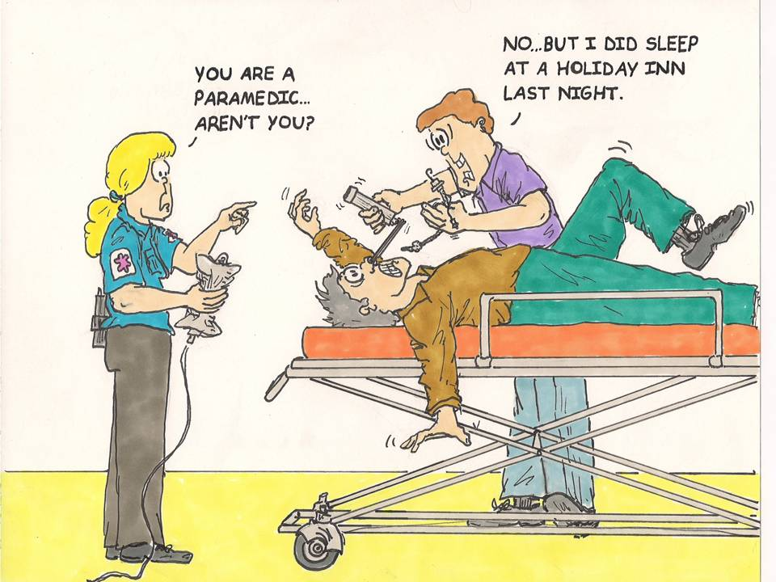
The Difficult Airway

